Slide 1

Datawarehouse Comparisons: SQL vs. Snowflake
Rehan Khan

Slide 2



Agenda
Introduction
Problem
Goal
Process
Conclusion

Slide 3




Introduction
For this project, we wanted to understand some of the key differences between using Microsoft SQL Server and Snowflake as a data warehouse solution. We took a sample dataset and used it to run several tests to conclude which warehouse was a better fit from an MLOps perspective.

Slide 4

Problem
In the context of ML Ops, where efficient data management is crucial for deploying and scaling machine learning models, the problem lies in identifying the optimal data warehousing solution between Microsoft SQL Server and Snowflake. In this project we want to know the differences between columnar and row-level databases, as it directly impacts the speed of data retrieval, processing, and manipulation essential for training and deploying machine learning models effectively.

Slide 5
Goal
To get an overall understanding of the most efficient databases, as well as understand the differences between columnar and row-level database formats. In this project, we will be comparing Snowflake to SQL

Slide 6
Project timeline and steps
II. ETL
Measure load times, document ETL process
III. Analytical Benchmarking
Complete, wrangling, EDA and modeling to test load times and capabilities of both systems.
IV. Warehouse Selection
I. Choose Dataset
Choose schema to test in both systems
Select more suitable data warehouse solution.

Slide 7

Dataset
Adventure Works 2022 Dataset

Slide 8
ETL
restored as a .bak file to Snowflake and Microsoft SQL Server.

Slide 9
ETL
Load times
SQL: Import Wizard ~ 10 minutes
Snowflake: Direct Import ~ 20 seconds

Slide 10
ETL
SQL - Setting Data Types up took another 10 minutes.
Snowflake – Autodetected data types accurately immediately upon dataset restore.

Slide 11
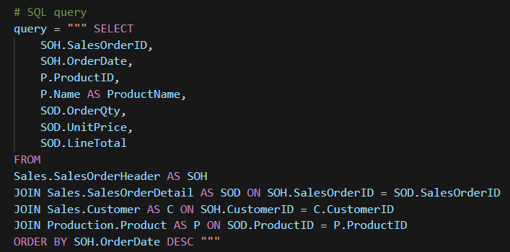
Analytical Benchmarking
Snippet of query that was used to populate data for python notebook we used to test differences between both systems.

Slide 12
Data used for comaprison
Column Name | Data Type | Content
SalesOrderID | integer | Unique ID for each individual order
OrderDate | date | Order Date
ProductID | integer | Unique ID for products sold
ProductName | string | Product name associated with ID
OrderQty | integer | Quantity of Units in order
UnitPrice | float | Price of item in USD
LineTotal | float | Total amount of order in USD

Slide 13
Analytical Benchmarking

Slide 14
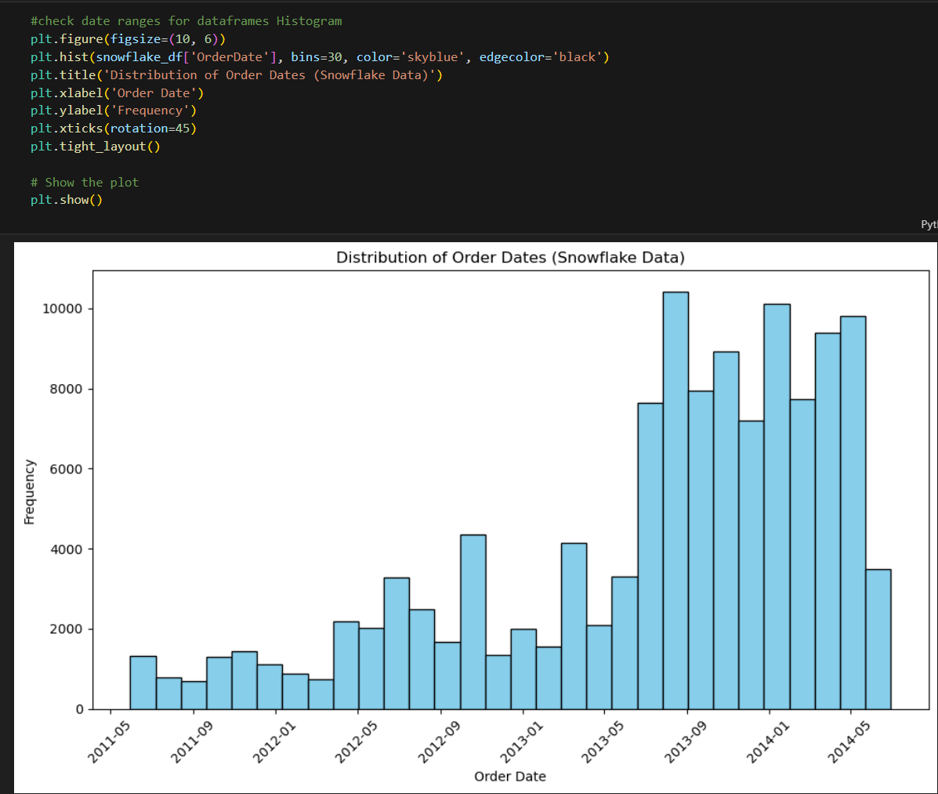
Exploratory Data Analysis
Figure on the right shows histogram of order dates taken from the Adventure Works query. We compared the same charts for both Snowflake and SQL. The chart on the right shows data from the Snowflake Dataframe.

Slide 15
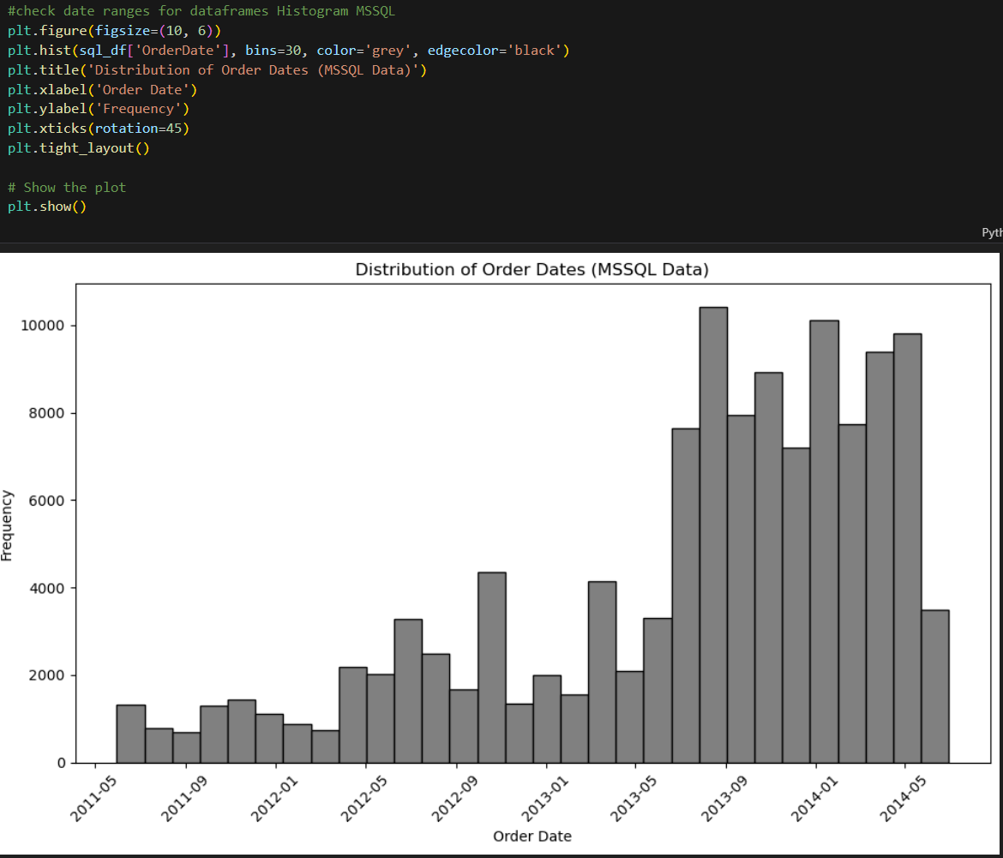
Exploratory Data Analysis
Figure on the right shows histogram of order dates taken from the Adventure Works query. We compared the same charts for both Snowflake and SQL. The chart on the right shows data from the SQL dataframe.

Slide 16
Speed Comparisons
Speed Comparison Factor | SQL Server | Snowflake | Winner
Query Performance | Performance dependent on hardware and optimization strategies. Can face scalability challenges with large datasets. | Designed for efficient large-scale data processing. Utilizes distributed architecture for parallel query processing. Automatic query optimization features. | Snowflake
Concurrency | Concurrency management may require careful configuration and monitoring. Supports concurrent transactions with locking mechanisms and isolation levels. | Excels in handling concurrent queries and workloads. Independent scaling of compute resources ensures high concurrency without performance degradation. | Snowflake
Data Loading and Processing | Efficient for smaller datasets or batch processing. May require optimization for large-scale data loading or real-time processing. | Optimized for data loading and processing at scale. Supports parallel loading from various sources. Automatic clustering and partitioning enhance performance. | Snowflake
Complex Analytics and Reporting | Supports complex analytics and reporting tasks through features like SSAS and SSRS. Performance may vary based on query complexity and data volume. | Robust support for complex analytics and reporting tasks. Scalable architecture ensures consistent performance for analytical workloads. | Snowflake

Slide 17
Cost Comaprison
Cost Factor | SQL Server | Snowflake | Winner
Initial Setup Cost | High | Low | Snowflake
Licensing Fees | Required | Subscription-based | Snowflake
Hardware Infrastructure | Need to purchase | Cloud-based, included in subscription | Snowflake
Maintenance & Upgrades | Requires dedicated IT team | Managed by Snowflake | Snowflake
Scalability | Limited scalability, may require additional hardware purchases | Easily scalable, pay for additional resources as needed | Snowflake
Performance | May require optimization | Optimized for performance | Snowflake
Data Storage | Generally requires purchasing storage upfront | Pay for storage used | Snowflake
Support | May require additional support contracts | Included in Snowflake subscription | Snowflake
Total Cost of Ownership | Potentially higher over time | Generally lower, predictable costs based on usage | Snowflake

Slide 18

Conclusion
In summary, we crafted a comparison in the following categories:
Scalability
Cost
Maintenance
Performance
Security
Speed
Integrations

Slide 19
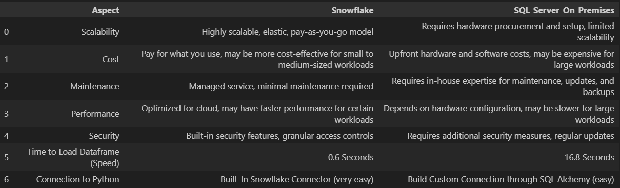
Conclusion
Based on these criterion we found Snowflake to be the better option.

Slide 20


Thank You

